Slide 1
Decision Tree Learning
Dr. Anil K Ahlawat

Slide 2
Inductive inference with decision trees
Decision Trees is one of the most widely used and practical methods of inductive inference
Features
  Method for approximating discrete-valued functions (including boolean)
  Learned functions are represented as decision trees (or if-then-else rules) to improve human readability
  Expressive hypotheses space,
  Capable of learning disjunctive expressions
  Robust to noisy data

Slide 3
When to consider Decision Trees
Instances describable by attribute-value pairs
Target function is discrete valued
Disjunctive hypothesis may be required
Possibly noisy training data
Missing attribute values
Examples:
  Medical diagnosis
  Credit risk analysis
  Object classification for robot manipulator (Tan 1993)

Slide 4
Decision tree representation (PlayTennis)
Decision trees classify instances by sorting them down the tree from the root to some leaf node, which provides the classification of the instance.
Each node in the tree specifies a test of some attribute of the instance, and each branch descending from that node corresponds to one of the possible values for this attribute.
An instance is classified by starting at the root node of the tree, testing the attribute specified by this node, then moving down the tree branch corresponding to the value of the attribute in the given example.

Slide 5
Decision tree representation (PlayTennis)
This process is then repeated for the subtree rooted at the new node.
Figure on next slide illustrates a typical learned decision tree. This decision tree classifies Saturday mornings according to whether they are suitable for playing tennis.
For example, the instance
<Outlook=Sunny, Temp=Hot, Humidity=High, Wind=Strong> would be sorted down the leftmost branch of this decision tree and would therefore be classified as a negative instance

Slide 6
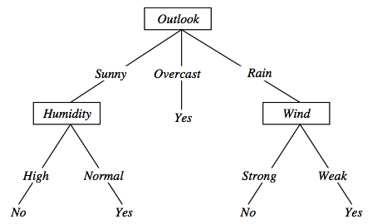
Decision tree representation (PlayTennis)
⟨Outlook=Sunny, Temp=Hot, Humidity=High, Wind=Strong⟩ No

Slide 7
Decision trees expressivity
Decision trees represent a disjunction of conjunctions on constraints on the value of attributes:
  (Outlook = Sunny ∧ Humidity = Normal) ∨
  (Outlook = Overcast) ∨
  (Outlook = Rain ∧ Wind = Weak)

Slide 8
Appropriate Problems for Decision Tree Learning
Instances are represented by discrete attribute-value pairs (though the basic algorithm was extended to real-valued attributes as well)
The target function has discrete output values (can have more than two possible output values --> classes)
Disjunctive hypothesis descriptions may be required
The training data may contain errors
The training data may contain missing attribute values

Slide 9
Top-down induction of Decision Trees
ID3 (Quinlan, 1986) is a basic algorithm for learning DT's
Given a training set of examples, the algorithms for building DT performs search in the space of decision trees
The construction of the tree is top-down. The algorithm is greedy.
The fundamental question is “which attribute should be tested next? Which question gives us more information?”
Select the best attribute
A descendent node is then created for each possible value of this attribute and examples are partitioned according to this value
The process is repeated for each successor node until all the examples are classified correctly or there are no attributes left

Slide 10
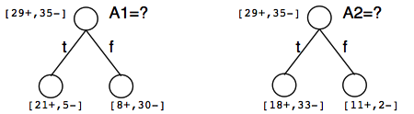
Which attribute is the best classifier?
A statistical property called information gain, measures how well a given attribute separates the training examples
Information gain uses the notion of entropy, commonly used in information theory
Information gain = expected reduction of entropy

Slide 11
Entropy in binary classification
Entropy measures the impurity of a collection of examples. It depends from the distribution of the random variable p.
  S is a collection of training examples
  p₊ the proportion of positive examples in S
  p– the proportion of negative examples in S
Entropy (S) ≡ – p₊ log₂ p₊ – p–log₂ p– [0 log₂0 = 0]
Entropy ([14+, 0–]) = – 14/14 log₂ (14/14) – 0 log₂ (0) = 0
Entropy ([9+, 5–]) = – 9/14 log₂ (9/14) – 5/14 log₂ (5/14) = 0.94
Entropy ([7+, 7– ]) = – 7/14 log₂ (7/14) – 7/14 log₂ (7/14) =
= 1/2 + 1/2 = 1 [log₂1/2 = – 1]
Note: the log of a number < 1 is negative, 0 ≤ p ≤ 1, 0 ≤ entropy ≤ 1
Notes:
Gain = Entropy (S) – (p+(weak) + p-(weak))Entropy (S weak) – (p+(strong) + p-(strong)Entropy (S strong)

Slide 12
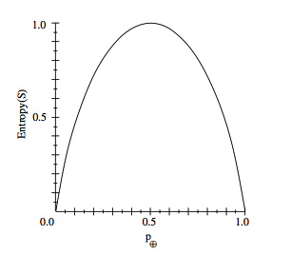
Entropy
Notes:
Plot di come varia l’entropia al crescere della proporzione degli esempi positivi.

Slide 13
Entropy in general
Entropy measures the amount of information in a random variable
H(X) = – p₊ log₂ p₊ – p– log₂ p– X = {+, –}
for binary classification [two-valued random variable]
c c
H(X) = – Σ p_{i} log₂ p_{i} = Σ p_{i} log₂ 1/ p_{i} X = {i, …, c}
i=1 i=1
for classification in c classes
Example: rolling a die with 8, equally probable, sides
8
H(X) = – Σ 1/8 log₂ 1/8 = – log₂ 1/8 = log₂ 8 = 3
i=1

Slide 14
Entropy and information theory
Entropy specifies the number the average length (in bits) of the message needed to transmit the outcome of a random variable. This depends on the probability distribution.
Optimal length code assigns ⎡− log₂ p⎤ bits to messages with probability p. Most probable messages get shorter codes.

Slide 15
Information gain as entropy reduction
Information gain is the expected reduction in entropy caused by partitioning the examples on an attribute.
The higher the information gain the more effective the attribute in classifying training data.
Notes:
La riduzione in entropia attesa partizionando sui valori dell’ attributo A

Slide 16
Example: expected information gain
Let
  Values(Wind) = {Weak, Strong}
  S = [9+, 5−]
  S_{Weak} = [6+, 2−]
  S_{Strong} = [3+, 3−]
Information gain due to knowing Wind:
  Gain(S, Wind) = Entropy(S) − 8/14 Entropy(S_{Weak}) − 6/14 Entropy(S_{Strong})
  = 0.94 − 8/14 × 0.811 − 6/14 × 1.00
  = 0.048
Notes:
Gain = Entropy (S) – (p+(weak) + p-(weak))Entropy (S weak) – (p+(strong) + p-(strong)Entropy (S strong)

Slide 17
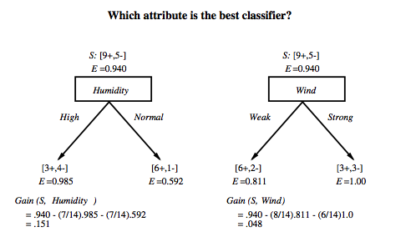
Which attribute is the best classifier?

Slide 18
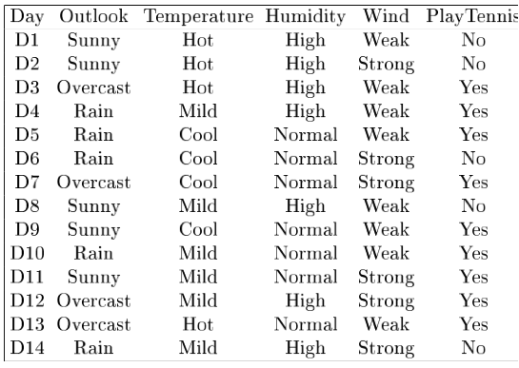
Example
Notes:
Target attrbute = playtennis

Slide 19
First step: which attribute to test at the root?
Which attribute should be tested at the root?
  Gain(S, Outlook) = 0.246
  Gain(S, Humidity) = 0.151
  Gain(S, Wind) = 0.084
  Gain(S, Temperature) = 0.029
Outlook provides the best prediction for the target
Lets grow the tree:
  add to the tree a successor for each possible value of Outlook
  partition the training samples according to the value of Outlook

Slide 20
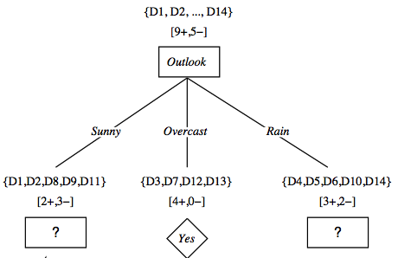
After first step

Slide 21
Second step
Working on Outlook=Sunny node:
  Gain(S_{Sunny}, Humidity) = 0.970 − 3/5 × 0.0 − 2/5 × 0.0 = 0.970
  Gain(S_{Sunny}, Wind) = 0.970 − 2/5 × 1.0 − 3.5 × 0.918 = 0 .019
  Gain(S_{Sunny}, Temp.) = 0.970 − 2/5 × 0.0 − 2/5 × 1.0 − 1/5 × 0.0 = 0.570
Humidity provides the best prediction for the target
Lets grow the tree:
  add to the tree a successor for each possible value of Humidity
  partition the training samples according to the value of Humidity

Slide 22
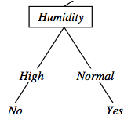
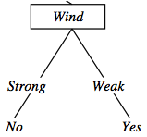
Second and third steps
{D1, D2, D8}
No
{D9, D11}
Yes
{D4, D5, D10}
Yes
{D6, D14}
No

Slide 23
Top-Down Induction of Decision Trees ID3
A ← the “best” decision attribute for next node
Assign A as decision attribute for node
3. For each value of A create new descendant
Sort training examples to leaf node according to
the attribute value of the branch
If all training examples are perfectly classified (same value of target attribute) stop, else iterate over new leaf nodes.

Slide 24
Which Attribute is ”best”?
[29+,35-]
A₁=?
A₂=?
[29+,35-]
True
False
True
False
[21+, 5-]
[8+, 30-]
[18+, 33-]
[11+, 2-]

Slide 25
ID3: algorithm
ID3(X, T, Attrs) X: training examples:
T: target attribute (e.g. PlayTennis),
Attrs: other attributes, initially all attributes
Create Root node
If all X's are +, return Root with class +
If all X's are –, return Root with class –
If Attrs is empty return Root with class most common value of T in X
else
A ← best attribute; decision attribute for Root ← A
For each possible value v_{i} of A:
- add a new branch below Root, for test A = v_{i}
- X_{i} ← subset of X with A = v_{i}
- If X_{i} is empty then add a new leaf with class the most common value of T in X
else add the subtree generated by ID3(X_{i}, T, Attrs − {A})
return Root

Slide 26
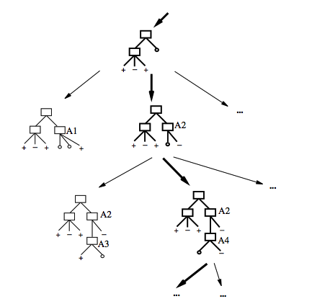
Search space in Decision Tree learning
The search space is made by partial decision trees
The algorithm is hill-climbing
The evaluation function is information gain
The hypotheses space is complete (represents all discrete-valued functions)
The search maintains a single current hypothesis
No backtracking; no guarantee of optimality
It uses all the available examples (not incremental)
May terminate earlier, accepting noisy classes

Slide 27
Inductive bias in decision tree learning
What is the inductive bias of DT learning?
Shorter trees are preferred over longer trees
Not enough. This is the bias exhibited by a simple breadth first algorithm generating all DT's e selecting the shorter one
Prefer trees that place high information gain attributes close to the root
Note: DT's are not limited in representing all possible functions

Slide 28
Two kinds of biases
Preference or search biases (due to the search strategy)
  ID3 searches a complete hypotheses space; the search strategy is incomplete
Restriction or language biases (due to the set of hypotheses expressible or considered)
  Candidate-Elimination searches an incomplete hypotheses space; the search strategy is complete
A combination of biases in learning a linear combination of weighted features in board games.

Slide 29
Issues in decision trees learning
Overfitting
  Reduced error pruning
  Rule post-pruning
Extensions
  Continuous valued attributes
  Alternative measures for selecting attributes
  Handling training examples with missing attribute values
  Handling attributes with different costs
  Improving computational efficiency
  Most of these improvements in C4.5 (Quinlan, 1993)
Notes:
L'overfitting può succedere quando c' è rumore nei dati.

Slide 30
Overfitting: definition
Building trees that “adapt too much” to the training examples may lead to “overfitting”.
Consider error of hypothesis h over
  training data: error_{D}(h) empirical error
  entire distribution X of data: error_{X}(h) expected error
Hypothesis h overfits training data if there is an alternative hypothesis h' ∈ H such that
error_{D}(h) < error_{D}(h’) and
error_{X}(h’) < error_{X}(h)
i.e. h’ behaves better over unseen data
Notes:
L' errore sul training e' minore e quindi ci appare come la migliore ipotesi
Ma l' errore nello spazio di tutti I possibili dati è maggiore.

Slide 31
Example
D15 Sunny Hot Normal Strong No
Notes:
L’ esempio D15 è sbagliato, introduce rumore nei dati.

Slide 32
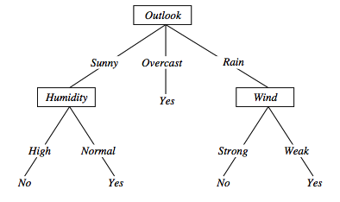
Overfitting in decision trees
⟨Outlook=Sunny, Temp=Hot, Humidity=Normal, Wind=Strong, PlayTennis=No ⟩
New noisy example causes splitting of second leaf node.
Notes:
The example shows that noise can lead to overfitting.
Overfitting without noise is also possible, especially when classifcation decision on the leafs are based on few examples. Uniform classification may be a coincidence.
This is a potential cause of overfitting.
Overfitting is a significant problem for DT, reducing the accuracy to 10-25% on many problems.

Slide 33
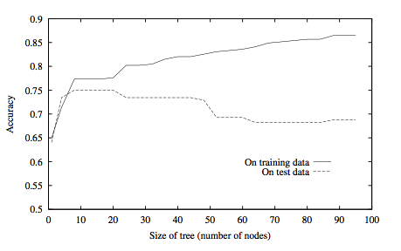
Overfitting in decision tree learning
Notes:
ID3 is used to learn which medical patients have a form of diabetes.
Horizontal axis reports number of nodes in the tree
Vertical axis the accuracy of the prediction
The accuracy on the training keeps growing while accuracy on the test data grows up to trees with 25 node then starts decreasing.

Slide 34
Avoid overfitting in Decision Trees
Two strategies:
  Stop growing the tree earlier, before perfect classification
  Allow the tree to overfit the data, and then post-prune the tree
Training and validation set
  split the training in two parts (training and validation) and use validation to assess the utility of post-pruning
    Reduced error pruning
    Rule pruning
Other approaches
  Use a statistical test to estimate effect of expanding or pruning
  Minimum description length principle: uses a measure of complexity of encoding the DT and the examples, and halt growing the tree when this encoding size is minimal
Notes:
Usando tutti dati di training, un test statistico può predire l’ influenza delle decisioni se espandere (o potare) sulle prestazioni su tutto X.
Minimum description length principle, un principio di compattezza della rappresentazione.

Slide 35
Reduced-error pruning (Quinlan 1987)
Each node is a candidate for pruning
Pruning consists in removing a subtree rooted in a node: the node becomes a leaf and is assigned the most common classification
Nodes are removed only if the resulting tree performs no worse on the validation set.
Nodes are pruned iteratively: at each iteration the node whose removal most increases accuracy on the validation set is pruned.
Pruning stops when no pruning increases accuracy
Notes:
Potatura sulla base di errori ridotti, valutati sul validation set.

Slide 36
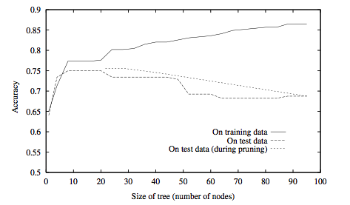
Effect of reduced error pruning
Notes:
The new line shows accuracy on test data

Slide 37
Rule post-pruning
Create the decision tree from the training set
Convert the tree into an equivalent set of rules
  Each path corresponds to a rule
  Each node along a path corresponds to a pre-condition
  Each leaf classification to the post-condition
Prune (generalize) each rule by removing those preconditions whose removal improves accuracy …
  … over validation set
  … over training with a pessimistic, statistically inspired, measure
Sort the rules in estimated order of accuracy, and consider them in sequence when classifying new instances

Slide 38
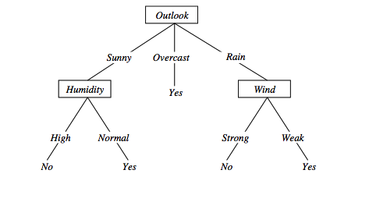
Converting to rules
(Outlook=Sunny)∧(Humidity=High) ⇒ (PlayTennis=No)

Slide 39
Why converting to rules?
Each distinct path produces a different rule: a condition removal may be based on a local (contextual) criterion. Node pruning is global and affects all the rules
In rule form, tests are not ordered and there is no book-keeping involved when conditions (nodes) are removed
Converting to rules improves readability for humans

Slide 40
Dealing with continuous-valued attributes
So far discrete values for attributes and for outcome.
Given a continuous-valued attribute A, dynamically create a new attribute A_{c}
A_{c} = True if A < c, False otherwise
How to determine threshold value c ?
Example. Temperature in the PlayTennis example
  Sort the examples according to Temperature
  Temperature 40 48 | 60 72 80 | 90
  PlayTennis No No 54 Yes Yes Yes 85 No
  Determine candidate thresholds by averaging consecutive values where there is a change in classification: (48+60)/2=54 and (80+90)/2=85
  Evaluate candidate thresholds (attributes) according to information gain. The best is Temperature_{>54}.The new attribute competes with the other ones

Slide 41
Problems with information gain
Natural bias of information gain: it favours attributes with many possible values.
Consider the attribute Date in the PlayTennis example.
  Date would have the highest information gain since it perfectly separates the training data.
  It would be selected at the root resulting in a very broad tree
  Very good on the training, this tree would perform poorly in predicting unknown instances. Overfitting.
The problem is that the partition is too specific, too many small classes are generated.
We need to look at alternative measures …

Slide 42
An alternative measure: gain ratio
    c |S_{i} | |S_{i} |
SplitInformation(S, A) ≡ − Σ log₂ i=1 |S | |S |
S_{i} are the sets obtained by partitioning on value i of A
SplitInformation measures the entropy of S with respect to the values of A. The more uniformly dispersed the data the higher it is.
Gain(S, A)
GainRatio(S, A) ≡
SplitInformation(S, A)
GainRatio penalizes attributes that split examples in many small classes such as Date. Let |S |=n, Date splits examples in n classes
  SplitInformation(S, Date)= −[(1/n log₂ 1/n)+…+ (1/n log₂ 1/n)]= −log₂1/n =log₂n
Compare with A, which splits data in two even classes:
  SplitInformation(S, A)= − [(1/2 log₂1/2)+ (1/2 log₂1/2) ]= − [− 1/2 −1/2]=1
Notes:
2^{-x} = 1/2^{x}

Slide 43
Adjusting gain-ratio
Problem: SplitInformation(S, A) can be zero or very small when |S_{i} | ≈ |S | for some value i
To mitigate this effect, the following heuristics has been used:
  compute Gain for each attribute
  apply GainRatio only to attributes with Gain above average
Other measures have been proposed:
  Distance-based metric [Lopez-De Mantaras, 1991] on the partitions of data
  Each partition (induced by an attribute) is evaluated according to the distance to the partition that perfectly classifies the data.
  The partition closest to the ideal partition is chosen
Notes:
Caso limite |S1|=0 |S2|=n
SplitInformation = - [0/n * log 0/n + n/n * log n/n] = - 0 - 0 = 0
GainRatio indefinito

Slide 44
Handling incomplete training data
How to cope with the problem that the value of some attribute may be missing?
  Example: Blood-Test-Result in a medical diagnosis problem
The strategy: use other examples to guess attribute
  Assign the value that is most common among the training examples at the node
  Assign a probability to each value, based on frequencies, and assign values to missing attribute, according to this probability distribution
Missing values in new instances to be classified are treated accordingly, and the most probable classification is chosen (C4.5)

Slide 45
Handling attributes with different costs
Instance attributes may have an associated cost: we would prefer decision trees that use low-cost attributes
ID3 can be modified to take into account costs:
Tan and Schlimmer (1990)
Gain²(S, A)
Cost(S, A)
Nunez (1988)
2^{Gain(S, A)} − 1
(Cost(A) + 1)^{w} _{w ∈ [0,1]}

